Slide 1
How to Reduce Money Leakage During Work Replacement?
Eyal Carmel, David Leiser, Avia Spivak
Ben - Gurion University of the Negev
Notes:
http://lawoffice.org.il/en/articles/pensions-severance-pay-israel/
http://mof.gov.il/ChiefEcon/EconomyAndResearch/ArticlesSet/Article_2016323.pdf

Slide 2
Pension in Israel
Pension in Israel is mandatory
Employees can withdraw tax-free compensation (severance payments)
Become an issue

Slide 3
Broad Misunderstanding
What would happened to the compensation funds if you won’t withdraw it? (N=470; age=50+)
52%
48%
Spivak A., Zemach S., Carmel E., Leiser D. 2017. The Mandatory Pension Reform in Israel: Characteristics And Achievements. Report for The National Insurance Institute of Israel
Notes:
No such difference at the actual withdrawals

Slide 4
Methodology
On-Line Survey
(research center)
129
Participants
Students
Psychology department
“During work replacement, workers need to make several personal decisions.
Please indicate how would you act on each of the following choices:”
Whether to take a company car or vehicle reimbursement
Whether to join a group health insurance at your new workplace
Employee stock options vs. increased salary
Whether to withdraw compensations from your pension account

Slide 5
Research Setting
Control Group
Experimental Group
“During work replacement employees are often entitled to receive certain amount of money, often labeled as ‘compensation’…
Imagine that you switch jobs …
How likely are you to take the compensation funds?”
“During work replacement employees are often entitled to withdraw money from their pension saving account, often labeled as ‘compensation’…
Imagine that you switch jobs….
How likely are you to withdraw compensation funds instead of leaving it in your pension account?”

Slide 6
Results
3.8
2.8
Not Informed
Informed
 | Not Informed | Informed
Very Likely | 38 | 6
Likely | 23 | 26
No Preference | 23 | 18
Unlikely | 14 | 44
Very Unlikely | 2 | 6
***No main effect for financial literacy***

Slide 7
Inconsistent Pension Behavior
How much money would you take from your pension account if you had the chance? 71% - I won’t take money from my account
Would you cash out your compensation during work replacement? 54% - NO (unlikely/very unlikely)
Also among respondents who knew that they would
get the money at retirement
Spivak A., Zemach S., Carmel E., Leiser D. 2017. The Mandatory Pension Reform in Israel: Characteristics And Achievements. Report for The National Insurance Institute of Israel

Slide 8
Mental Accounting
Tendency to withdraw depends on perception of the funds as:
Long-term saving → leave it on retirement saving account
Unexpected gain → spend it

Slide 9
Methodology
On-Line Survey
(research center)
383
Participants
18-60
Years Old
“During work replacement, workers need to make several personal decisions.
Please indicate how would you act on each of the following choices:”
Whether to take a company car or vehicle reimbursement
Whether to join a group health insurance at your new workplace
Employee stock options vs. increased salary
Whether to withdraw compensations from your pension account

Slide 10
Research Setting
Control Group
Windfall
Savings
“During work replacement employees are often entitled to receive certain amount of money, often defined as ‘compensation’…
Imagine that you switch jobs …
How likely are you to take the compensation funds?”
“During work replacement employee are often entitled to take compensation… Imagine that you switch jobs and need to decide… How likely are you to take the compensation instead of adding it to your pension account”
“During work replacement employee are often entitled to withdraw compensation … Imagine that you switch jobs and need to decide… How likely are you to withdraw the compensation instead of leaving it in your pension account”

Slide 11
Mental Accounts
When framed as part of retirement savings account subjects were reluctant to withdraw the compensation
**
*
Savings
Windfall
Control
[p<.001; η_{p}²=.18]

Slide 12
Summary
01
People do not know that they would get the money on their retirement
02
People who perceived compensation funds as an integral part of their long-term savings are less likely to withdraw
03
We recommend ‘choice architecture’ of withdrawals request forms: e.g., clarity, simplicity, framing, timely presentation of knowledge
Sound trivial?

Slide 13
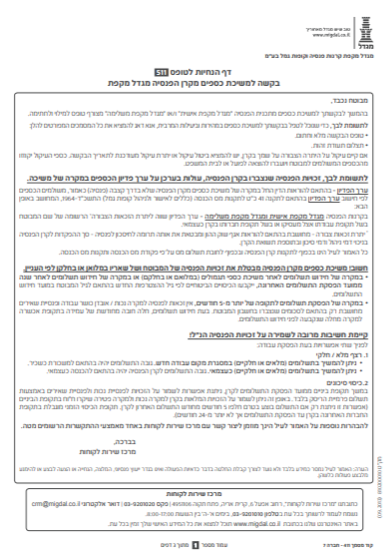
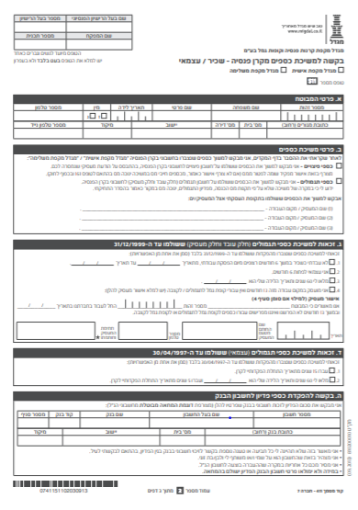
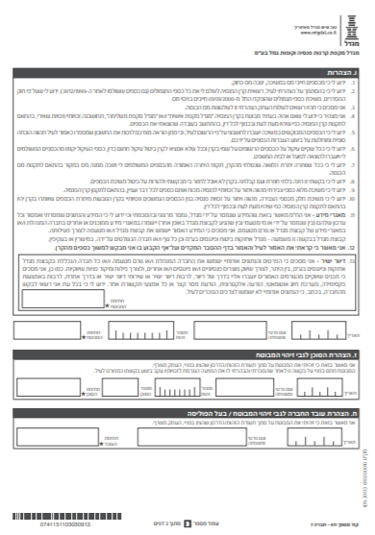
Withdrawal Request Form
Please note that the pension rights accrued in your fund would be lower in value in case of withdrawal

Slide 14
Thank You For Listening!
Eyal Carmel
Carmeley@post.bgu.ac.il

