Slide 1
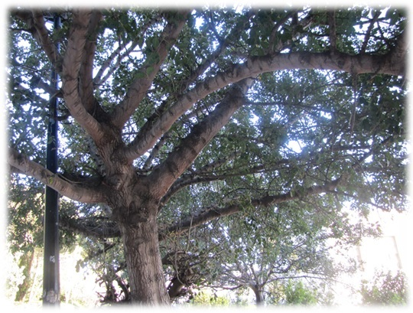
Beyond Pensions: A Radical Systems-Based
Transformation Of Present-Future Choice
Moshe Gerstenhaber
Shlomo Maital
Tsipy Buchnik
The Fund for the Advancement of Humanities Seminar on Aging, Retirement and Pensions: Trends, Challenges and Policy
March 27-29, 2018
Leonardo Hotel Ashkelon

Slide 2
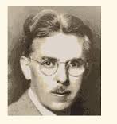

It is better to ask some of the questions than to know all the answers.
(James Thurber)
How can we nudge democratic societies toward greater deferred gratification (saving), when both the economic and political systems are powerfully biased toward instant gratification (spending)?
How can we willingly transfer substantial resources from present to (distant) future ?
What is the key underlying core problem, that generates the so-called “pension crisis”?

Slide 3
First Question
(for those approaching retirement)
Are you confident that your retirement income will be sufficient for your reasonable retirement needs?
“Among the least wealthy half of Britain, the average household has on average just £ 3200 of net financial, property and pension wealth”
(Source: The IPPR Commission on Economic Justice, Oct. 2017, Wealth in the Twenty First Century: ‘Inequality and Drivers‘)
Notes:
Show of hands

Slide 4
Second Question
(for those with children)
Are you confident that the retirement income of your children will be sufficient for their reasonable retirement needs?
“Those fortunate enough to be at or close to retirement, or in public jobs, look set to benefit, while the young and self-employed are deemed to be getting an unfair deal” (Source: Hugh Nolan, President of the Society of Pension Professionals, referring to their 2017 survey results)
“2/3 of retirees who have not saved enough only realised their mistake after stopping work”
(Source: Aviva Report: ‘Retirement Uncovered: A qualitative research project by Britain Thinks’, 2014)
Notes:
Show of hands

Slide 5
Third Question
(for everyone)
Do you trust the integrity of the current pension system?
Namely: That your pension expectations are secure?
“Boris Johnson’s pension tsar has warned that the National Health Service faces a half-trillion Pound pension deficit and urged the government to tackle generous public sector retirement packages that have become unaffordable ….” “The cost to the taxpayer of funding the retirement of 1.3 million former and present NHS staff was close to paying £ 500 billion” (Source: Harry Wilson and Martin Waller, The Times, 2015)
“The UK has run up a national pension deficit of more than £ 400 billion ($ 518 billion) over the past decade, becoming the biggest liability to the economy”
HSBC Head of European Credit Strategy Jamie Stuttard warned in a recent note that Governor Mark Carney’s monetary policy means: “The pension issue is essentially kicked down the road for somebody else to sort out” (Source: uk.businessinsider.com, Oscar Williams-Grant, 2016)
Notes:
Show of hands

Slide 6
Are our pensions safe in the future?
Will the pay-as-you-earn system work?
The Annual Median Equivalent Adult Income (US$)
of the following populations:
Question:
Will people earning at most the Median Income (as above) be able to fund from their income the retirement, health care and age care costs of the aging population?
(Source: Wikipedia, based on Gallup, “New Means of Global Income”, from Gallup World Poll, December 13, 2013)
“Disposable income is shown in United States Dollars at current purchasing power parity for private consumption”

Slide 7
In Gerstenhaber et al. (2016) we presented a radical solution based on raising national saving and capital formation by 0.5 % of GDP each year for two decades.
The resulting rise in total factor productivity, GDP growth and social return on capital will make pension funds solvent.
But -- how in the world can public policy, shaped within democratic systems, achieve this dramatic and essential rise (albeit incremental, over two decades) in saving, when modern economies are driven by debt and spending, in turn driven by inability to defer gratification.
Gerstenhaber, M., S. Maital & T. Buchnik. “Beyond Pensions: A Radical Systems-Based Transformation of Present-Future Choice”. Journal of Organizational Transformation & Social Change. 13 (3), Nov. 2016, 168-194

Slide 8
The Simple Arithmetic of the Pension Crisis
Suppose you work for 40 years, from age 25 to age 65.
Suppose you save 20% of your net income, including your employers’ pension contributions.
That means you have saved 8 years’ income (20% x 40)
.. But that sum will have to pay for at least 20 years of retirement, and perhaps more.
Compound interest?
Interest rates are extremely low and are unlikely to rise much in the coming years.
S times R times T
Compounded Capital Growth Over The Long Term Is The Key To Retirement Income

Slide 9

Behavioral Economics / Economic Psychology
to the Rescue
Clue: China, a command economy, has shifted from export and investment driven growth (future)
toward consumption driven growth (present).
Has any democratic society
done the opposite? (in time of peace)
How????

Slide 10
How will it work: The Magic of the NIS 5 Coin
The Carob Tree will be a national initiative for economic regeneration where each new-born child is granted at birth a new pension account: The 4th Pillar Pension
The State will deposit into this personal account the equivalent of US$10,000.—
These Government-Grant-at-Birth moneys of all the children born each year will be invested directly in the real economy (of Israel) to compound for 70 years.
The cost? Approx. NIS 5 per day per household and NIS 5 per working day per employee.

Slide 11
The Super Trusts:
Transforming the Future
The combined funds (in Israel adding up to some US$1.8 billion p.a.) will be invested by a new breed of competing and cooperating investment structures to be called The Super Trusts (a new one launched every three years with US$5.4 billion in capital).
The Super Trusts will invest directly in the real economy (not in financial speculation) to create new work opportunities, skills training, support for the SME sector, renew infrastructure, build housing including rental housing, and much more. Producing far greater Distributed Prosperity. Equity re-balanced the natural way: Through distributed growth.

Slide 12
Revitalising the National Economy
The most urgent task today is to find a way to revitalise the ‘real economy’ of the nation.
In order to deliver work skills and opportunity to the individual and distributed prosperity to the citizenship as a whole it is necessary to boost the rate of tangible investment in the real economy and thereby speed up productivity development and economic growth (macro and micro).
The economy of the future is becoming more competitive and wealth more concentrated in the hands of the few. Robots are stimulating productivity by replacing human labour on a vast scale.
The Carob Tree’s focus on compounding investment in the real economy for 70 years will be a non-partisan, independent force for shared good.

Slide 13
The 4th Pillar Pension: Senior Universal Basic Income
The 4th Pillar capital will start to pay a monthly pension to every surviving individual from age 70.
The reducing capital balances will continue to be invested with a return calculated at 5% p.a. net compounded.
On the basis of the above it is estimated that the 4th Pillar will be able to deliver an additional pension of some US$1,850.— per month per individual from age 70 to the last day of each surviving individual (pension calculated age 70 – 95).

Slide 14
The Stock Market Option?
In contrast to the Carob Tree investments which are designed to transform the real economy, the current pension funds are substantially invested in various stock markets. This means that buying and selling equity (existing shares mostly) is expected to be a sustainable way to provide security for the nation’s retirees for 20 – 30 years.
Is this expectation a realistic one for the future?
Relentless financial speculation and growing debt are stoking the fires of the next economic crisis

Slide 15
Stock Markets for Pensions?
“Unhappy Returns”
Professor Paul Krugman
(Noble Prize Laureate Economics) writes:
“I asked Dean Baker, of the Center for Economic and Policy Research, to help me out with that calculation (there are some technical details I won't get into).
Here's what we found: by 2050, the price-earnings ratio would have to rise to about 70.
By 2060, it would have to be more than 100.”
Source: Many Unhappy Returns, Paul Krugman, The Opinion Pages, OP-ED Columnist, The New York Times, February 1, 2005

Slide 16
Is Sustainability A Value We Seek?
A practical real economy model delivering individual opportunity and distributed prosperity to all has a much better chance to survive over time than a model where “1 % of the global population owns more wealth than the other 99%” (Source: Oxfam, 2015)
“More than 80% of the wealth in the United States belongs to 20% of the population”
(Source: Associate Professor of Business at Harvard University, in an article ‘What we know about wealth’, by Elizabeth Gudrais, Harvard Magazine 2011)
“The more godlike he becomes the less godlike Homo economicus behaves” (Source: A. Nikiforuk, ‘At War With Our Planet’, 2006)

Slide 17
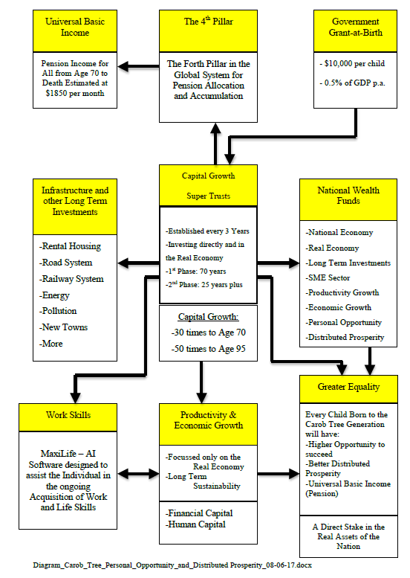
We must
Embrace a
systems
approach

Slide 18

Universal Basic Income for All??
VISIT THIS WEBSITE:
http://www.arpconference.com/
FOR MORE DETAILED INFORMATION, ON HOW THE CAROB TREE SYSTEM CAN DELIVER A SUSTAINABLE ECONOMIC MODEL FOR SOCIETY AND A SENIOR UNIVERSAL BASIC INCOME TO ALL FROM AGE 70 UNTIL DEATH

