Slide 1

The Effects of Increasing the Formal Retirement Age on Labor Supply:
Gender and Family Considerations
Reut Avioz
The Hebrew University
and
Ayal Kimhi
The Hebrew University and Shoresh Institution

Slide 2
Motivation
During 2004-2009 the formal retirement age in Israel was raised gradually from 65 to 67 for men and from 60 to 62 for women.
Much of the literature in this area examined the effect of raising the retirement age on employment.
Much less is known about:
  The effect on hours of work
  The differential effect by marital status

Slide 3
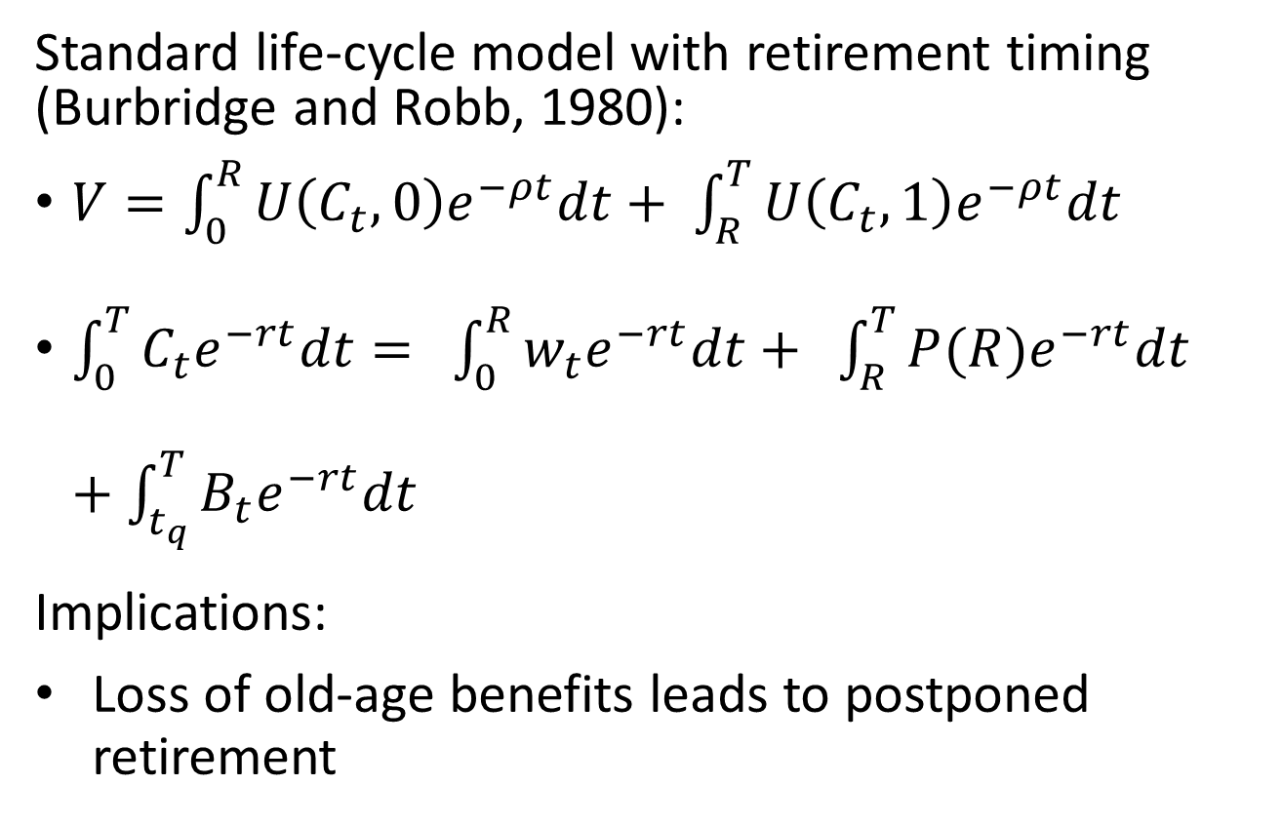
Theoretical background (1)
Standard life-cycle model with retirement timing (Burbridge and Robb, 1980):
$V=\int_{0}^{R}{U\left(C_{t},0\right)e^{−ρt}dt+ \int_{R}^{T}{U\left(C_{t},1\right)e^{−ρt}dt}}$
$\int_{0}^{T}{C_{t}e^{−rt}dt}= \int_{0}^{R}{w_{t}e^{−rt}dt}+ \int_{R}^{T}{P(R)e^{−rt}dt}+\int_{t_{q}}^{T}{B_{t}e^{−rt}dt}$
Implications:
Loss of old-age benefits leads to postponed retirement

Slide 4
Literature (1)
Increasing the formal retirement age postpones actual retirement.
Mastrobuoni, 2009;
Hanel and Riphman, 2012;
Vogel, Ludwig and Borsch-Supan, 2017;
Atalay and Barrett, 2012;
Lalive and Staubli, 2015;
Staubli and Zweimuller, 2013;
Bank of Israel (2010).

Slide 5
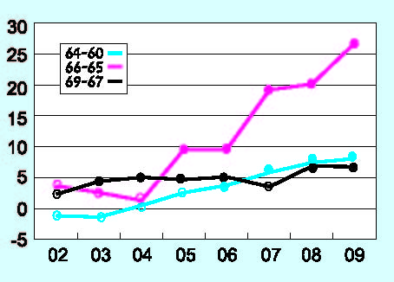
Increase in male employment (BoI 2010)
* Compared to 50-59 years-old males in 2001

Slide 6
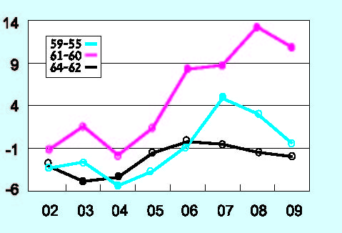
Increase in female employment* (BoI 2010)
* Compared to 50-54 years-old females in 2001

Slide 7
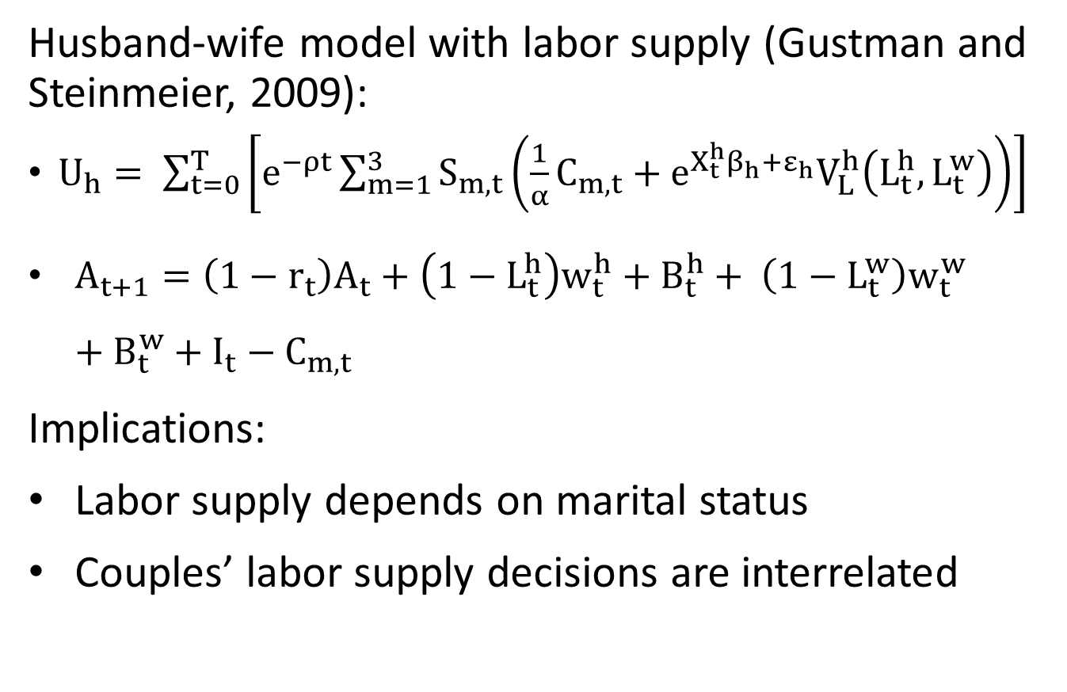
Theoretical background (2)
Husband-wife model with labor supply (Gustman and Steinmeier, 2009):
$U_{h}= \sum_{t=0}^{T}{\left[e^{−ρt}\sum_{m=1}^{3}{S_{m,t}\left(\frac{1}{α}C_{m,t}+e^{X_{t}^{h}β_{h}+ε_{h}}V_{L}^{h}\left(L_{t}^{h},L_{t}^{w}\right)\right)}\right]}$
$A_{t+1}=\left(1−r_{t}\right)A_{t}+\left(1−L_{t}^{h}\right)w_{t}^{h}+B_{t}^{h}+ \left(1−L_{t}^{w}\right)w_{t}^{w}+B_{t}^{w}+I_{t}−C_{m,t}$
Implications:
Labor supply depends on marital status
Couples’ labor supply decisions are interrelated

Slide 8
Literature (2)
Married couples’ retirement decisions are:
positively correlated - leisure complementarity: Hurd, 1990; Gustman and Steinmeir, 2000; Michaud, 2003; Coile, 2004; Queiroz, 2006; Kapur and Rogowski, 2006; Honore and de Paula, 2013; Stancanelli, 2016; Johnson and Faverealut, 2001; Maestas, 2001.
negatively correlated – budget constraint: Gustman and Steinmeir, 2009; Stancanelli and van Soest, 2016.

Slide 9
Literature (3)
Cribb, Emerson and Tetlow (2015): husband’s employment rate increases with the increase in women’s retirement age – leisure complementarity.
Johnson and Favrealt (2001): people are more likely to retire if their spouse is already retired, but are less likely to retire if the spouse is retired for health reasons.
Martins, Novo and Portugal (2009): no effect of increasing the retirement age on hours of work of female employees in Portugal.

Slide 10
Empirical approach
Data from Israeli Labor Force Surveys.
66 year-old men and 61 year-old women, before (2001-2003) and after (2009-2011) the increase in the official retirement age.
Arabs are excluded because of very low LFP among Arab women in that age group.
Estimating work equations (Probit) and hours of work equations (Tobit) by gender, controlling for marital status, education, location and house size.

Slide 11
Descriptive statistics
males |  | females |  | Employment rate
after | before | after | before
40% | 25% | 49% | 28% | Married
38% | 17% | 44% | 26% | Unmarried
males |  | females |  | Hours of work|working
after | before | after | before
39.8 | 34.8 | 31.0 | 30.9 | Married
39.5 | 33.0 | 30.7 | 30.6 | Unmarried

Slide 12
Probit results
males |  | females |  | Probability of working
z-value | Marginal effect | z-value | Marginal effect | Variable
3.39 | 0.239** | 4.79 | 0.164** | "after"
0.18 | 0.007 | -0.10 | -0.003 | Married
-2.05 | -0.115* | -0.10 | -0.004 | Married*"after"
2.87 | 0.121** | 4.34 | 0.185** | High-school education
4.44 | 0.185** | 7.88 | 0.314** | Higher education
0.01 | 0.000 | 2.46 | 0.145* | HS education*"after
0.18 | 0.011 | 1.58 | 0.088 | Higher education*"after"
* P-value < 0.05 ** P-value < 0.01

Slide 13
Tobit results
males |  | females |  | Hours of work|working
z-value | Marginal effect | z-value | Marginal effect | Variable
3.26 | 7.49** | 1.38 | 1.88 | "after"
0.23 | 0.31 | -0.41 | -0.35 | Married
-2.12 | -3.61* | 0.43 | 0.46 | Married*"after"
2.96 | 4.17** | 4.24 | 5.24** | High-school education
4.46 | 6.25** | 7.99 | 9.09** | Higher education
-0.06 | -0.11 | 2.11 | 3.62* | HS education*"after
0.17 | 0.33 | 0.86 | 1.29 | Higher education*"after"
* P-value < 0.05 ** P-value < 0.01

Slide 14
Summary and conclusion
Employment rates have increased, more for unmarried males than for females, and less for married males.
Hours of work increased for all males and for females with high-school education, but less for married males.
Overall, the effect of increasing the retirement age does not change with marital status for females, but married males respond less than unmarried males.
Some of the married males have working wives, so they may be less affected by the postponement of old-age benefits.
Some of them have non-working wives, so they may have a higher value of leisure.
But why all this does not hold for females?

Slide 15
Future research…
Compare to people who are not affected by the increase in the retirement age.
Compare people whose spouses are below or above the retirement age.
Model the joint labor supply decisions of married couples.
  Condition on the labor supply of the spouse.

