Slide 1
The Idea of (Paid) Retirement
Avia Spivak
Center for Pensions, Insurance and Financial Literacy
Ben-Gurion University of the Negev
March 27, 2018

Slide 2
Paid retirement – a new invention
In the past, only the leisure class retired, but they never really worked: Greeks (non slaves), Benjamin Franklin, David Ricardo.
Business owners passed control to family at old age. This retirement was often not happy. (Edward Shorter, The making of the modern family).

Slide 3
The usual suspects for the emergence of pensions
The Industrial Revolution
The urbanization of America
The disappearance of the "extended" family
A marked increase in life expectancy
My additions:
The increased incidence of fatal and mutilating accidents.
The increase in the value of human work and life.

Slide 4
The Second Industrial Revolution in the US
By 1885, the industrial transformation of America was well underway. The small mills, tanneries, and mule-drawn canal barges of the pre-industrial era gave way to ever larger industrial age factories and steam belching railroads. Large, impersonal corporations became the dominant form of business organization. The national character took an increasingly urban air.

Slide 5
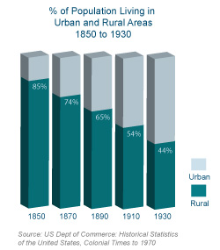

Slide 6
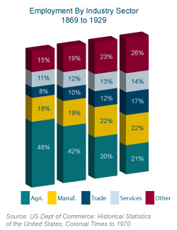
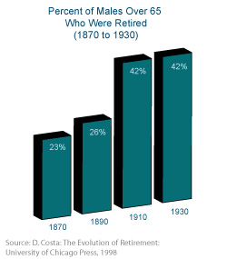

Slide 7
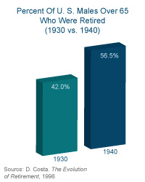
Social Security was a reaction to the increase in poverty among the elderly

Slide 8
The paternal state
Social Security Began in the U.S. in 1935

Slide 9
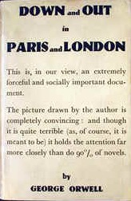
Orwell’s first novel (1933) raised consciousness about poverty in UK

Slide 10
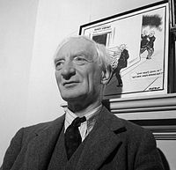
The Beveridge Report (1942) – the foundation of the post war welfare state
Poverty can be eradicated. Old age is one of the major causes of poverty.

Slide 11
2. From: Something Fresh (P.G. Wodehouse, 1911)
Father says he would give five thousand dollars to anyone who would get it back for him."
"What!"
The whole story took on a different complexion for Joan. Money talks. Mr. Peters' words might have been merely the rhetorical outburst of a heated moment; but, even discounting them, there seemed to remain a certain exciting substratum. A man who shouts that he will give five thousand dollars for a thing may very well mean he will give five hundred, and Joan's finances were perpetually in a condition which makes five hundred dollars a sum to be gasped at.
"You mustn't, Joan—really! don't think any more about it."
"Not think any more about it! My child, do you even faintly realize what five thousand dollars—or a quarter of five thousand dollars—means to me? I would do anything for it—anything! And there's the fun of it. I don't suppose you can realize that, either.

Slide 12
Was the extended family so good?
Dora L. Costa "Displacing the Family: Union Army Pensions and Elderly Living Arrangements." Journal of Political Economy. December 1997, 105(6): 1269-1292.
  Costa shows that once Army Veterans had their own means, they chose not to live with their children. Living together was not an ideal, but a constraint.
Leo Tolstoy delivers sharp criticism at the tyranny of fathers in the Russian family. In his classic short story Alyosha the Pot this young son cannot marry his love, he is abused and finally dies of a domestic accident. Nobody ever takes care of him. (The accident of course is not interrogated by the police).
Edward Shorter depicts the making of the modern family as a triumph of freedom from the chains of the traditional extended family.
And in Sweden some view the modern welfare state as a means to enhance personal freedom, (from the church and extended family) be it in child rearing, employment or retirement.

Slide 13
Some literary references about the low value of human capital before modern age
Our claim: the low value of human capital did not allow for saving for retirement.
Nor for financing retirement of others through social security systems.
Pride and Prejudice. Jane Austen (1813). Lizzy Bennet must marry to be settled financially. She is very intelligent and able, but there is no value in her work.

Slide 14
Paid retirement – prize or punishment?

Slide 15
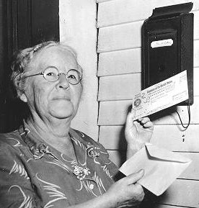
In PayGo system, the first generation gets a windfall

Slide 16
Paid retirement as a Prize
military retirement:
Veteran Pensions Civil War US
Land grant for Roman veterans after 25 years of service.
Today's military retirement after 20-25 years US,
Politicians and high officials:
Israel: Members of Parliament, Mayors, Judges, Bank of Israel, University Professors, new immigrants
A concealed prize. Motivation: unseen and unregulated payment, “taking care of our own”, complementing years of coverage where the person was serving the cause and not accumulating pension benefits.
In Israel the movement to DC stopped all this. Even beforehand, the Finance Ministry regulators stopped many of these excesses. (And for a good reason – it bordered on simple corruption).

Slide 17
As work became easier, retirement is viewed as punishment by some
Forced retirement is viewed as a manifestation of ageism. US Supreme court ruling against it.
Retirement is used as a way to make way for the young, solve the unemployment of the young. (European experimenting with early retirement in the late 1970s).
It is based on the idea (wrong in many economists’ view) of the limited amount of work.

Slide 18
Some current financing issues
Accumulation or Pay-as-you-go financing?
In the first pillar – PayGo; in the second pillar – accumulation.
Actuarial balancing – group vs. personal; DB vs. DC; incentives, the Swedish notional accounts and DC system.
Moral hazard – the abuse of insurance and the system; early retirement.
The demographic issues: longevity, low birth rate, immigration.

Slide 19
Pensions: Raising retirement ages and expanding private pension coverage essential, says OECD
Press release by OECD on the yearly report Pension in a Glance 2012
11/06/2012 - Governments will need to raise retirement ages gradually to address increasing life expectancy in order to ensure that their national pension systems are both affordable and adequate, according to a new OECD report. At a time of heightened global economic uncertainty, such reforms can also play a crucial role in governments’ responses to the crisis, contributing to fiscal consolidation at the same time as boosting growth.

Slide 20
Over the next 50 years, life expectancy at birth is expected to increase by more than 7 years in developed economies. The long-term retirement age in half of OECD countries will be 65, and in 14 countries it will be between 67 and 69. The Pensions Outlook 2012 says that increases in retirement ages are underway or planned in 28 out of the 34 OECD countries. These increases, however, are expected to keep pace with improved life expectancy only in six countries for men and in 10 countries for women. Governments should thus consider formally linking retirement ages to life expectancy, as in Denmark and Italy, and make greater efforts to promote private pensions.
“Bold action is required. Breaking down the barriers that stop older people from working beyond traditional retirement ages will be a necessity to ensure that our children and grand-children can enjoy an adequate pension at the end of their working life,” said OECD Secretary-General Angel Gurría. “Though these reforms can sometimes be unpopular and painful, at this time of tight public finances and limited scope for fiscal and monetary policy, these reforms can also serve to boost much needed growth in ageing economies.”

