Slide 1
Lay perceptions about pension
Hernan Rosenblum
David Leiser
Seminar on Aging, Retirement and Pensions: Trends, Challenges and Policy
March 27, 2018

Slide 2
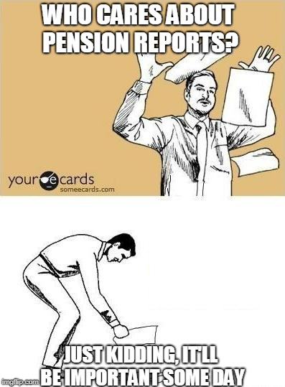
why misconceptions are important?
Notes:
Why is it important?
People have to act in a world with complex systems, regardless their level of understanding
An existing problem in willingness to engage with personal retirement saving
What did we try to do?
Identify existing bottlenecks of knowledge which are consequential with regard to maintaining an healthy retirement saving account
Identify populations which are more susceptible to lack of knowledge, and therefore more vulnerable to mismanagement of their savings
Measure correlations between knowledge and healthy savings behavior.

Slide 3
Lay theories regarding retirement savings
Notes:
Preliminary research
Based on open interviews collected by students from the psychology department in BGU, we noted two main repeating patterns:
The piggybank model
- sees the retirement savings as a personal savings acoount
Unaware of other peoples actions and descions on their savings
Individual responsibility to save up
Minimal to none state participation
The vault model
Based on the retirement system for workers in the public sector until the beginning of the millenium
Contract with the government\society
Conditions are pre-set
Government responsibility to keep their part of the agreement

Slide 4
The Questionnaire
Q1.1: To what degree is a personal retirement savings acoount is affected by other peoples savings in the same pension fund?
A. not all B. to a little extent C. somewhat D. to a large extent E.to a very large extent
Q1.6: How does the accumulated sum in the retirement savings account grow?
Interest Yes\No
The state adds money on it’s behalf Yes\No
Investment in the capital market Yes\No
Deposits only Yes\No
Notes:
Knowledge
Behavior
attitudes

Slide 5
The Questionnaire
Q2.12: Have you ever confirmed deposits into you retirement savings by your employer?
A. Yes B. NO
Q3.4: To what extent do you think it is justified to obligate all workers to save for retirement?
A. not all B. a little C. somewhat D. justified E. very justified
Notes:
Behavior – since we used a self report measurement it is probable that we got an over estimation of people’s behavior
attitudes

Slide 6
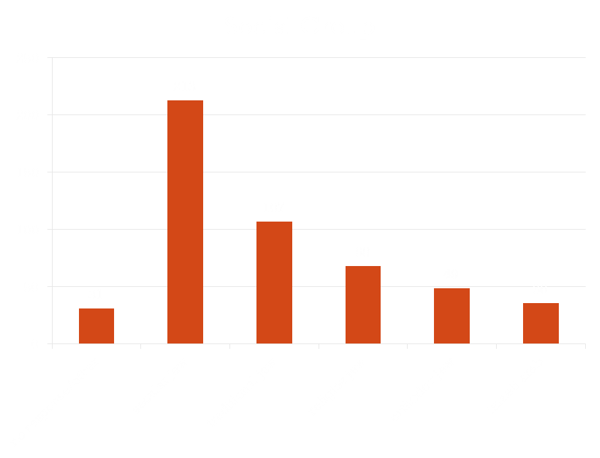
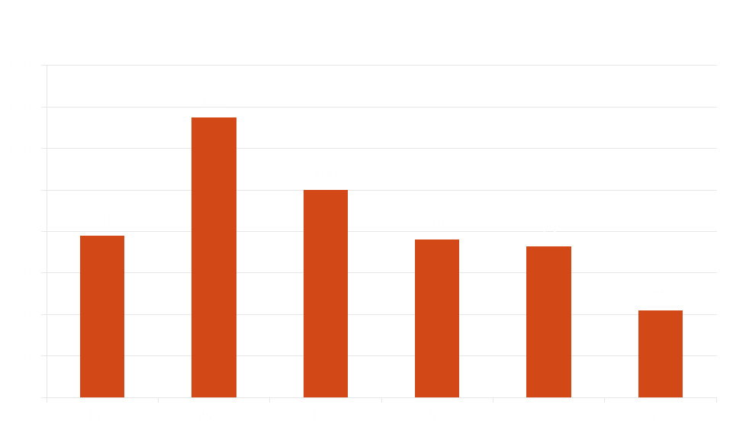
The sample
504 Participants
235 Males (46.6%), 269 Females (53.4%)
Notes:
*Completed the questionnaire
Misrepresentation for orthodox and arabs

Slide 7
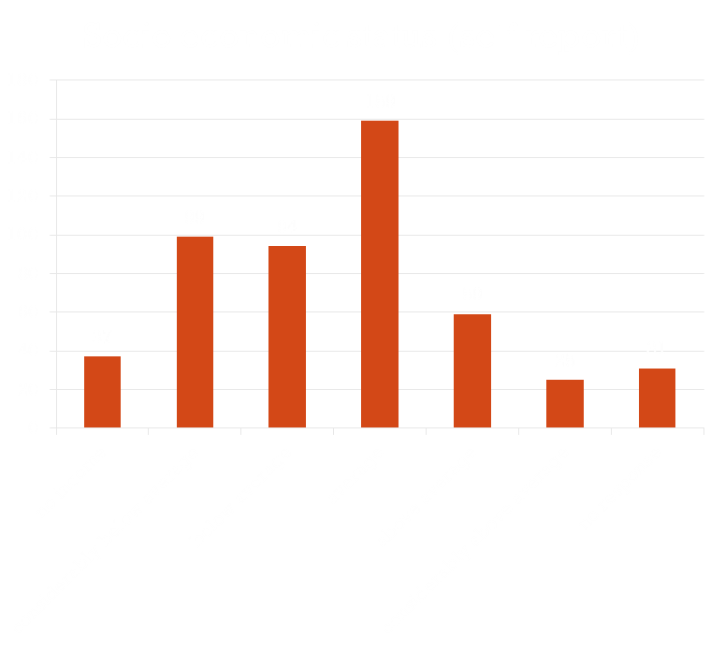
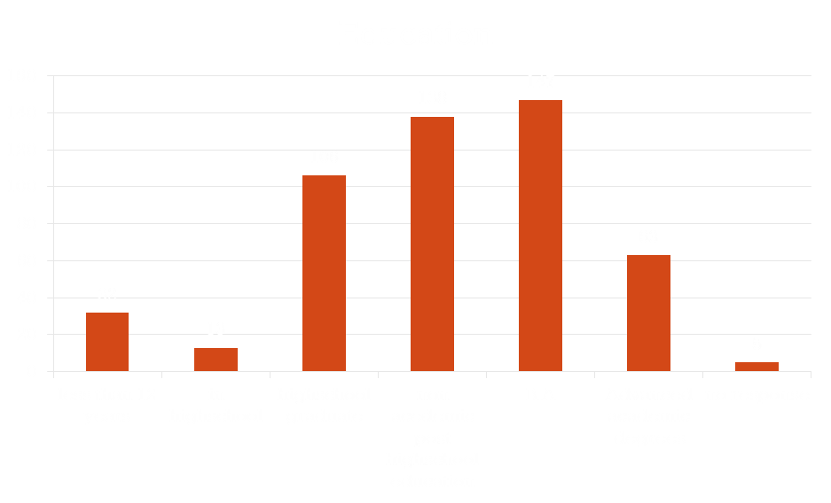
The sample
Notes:
*Completed the questionnaire

Slide 8
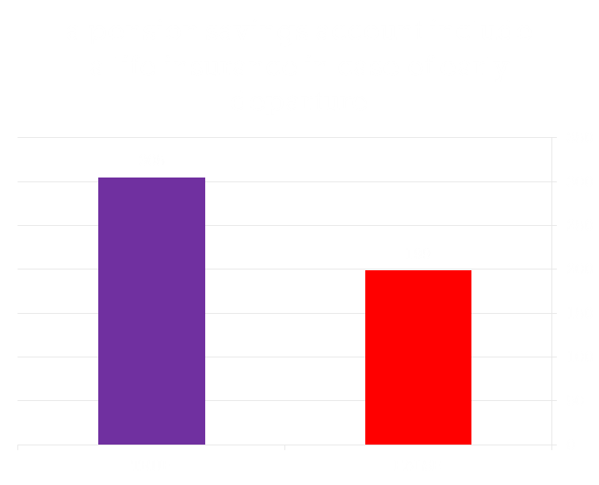
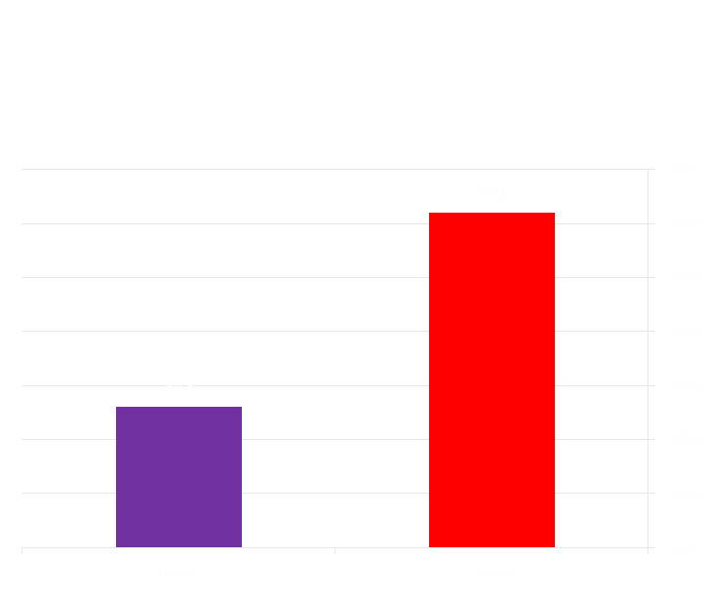
Descriptive results
Correlation between answers – 0.27
Notes:
Departure

Slide 9
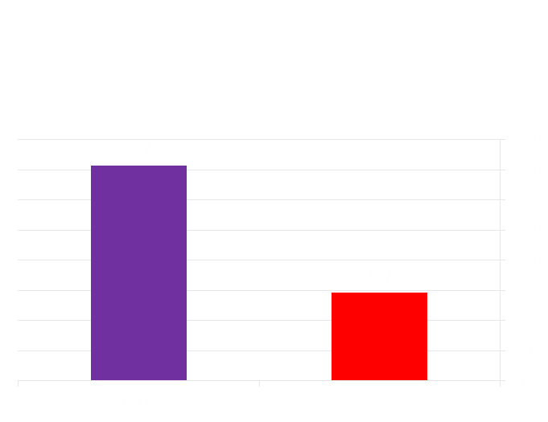
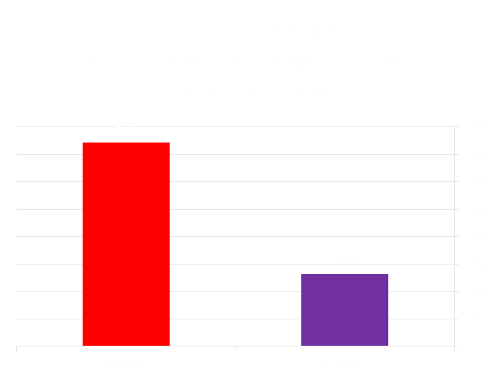
Descriptive results
Correlation between answers – 0.29
Notes:
Departure

Slide 10
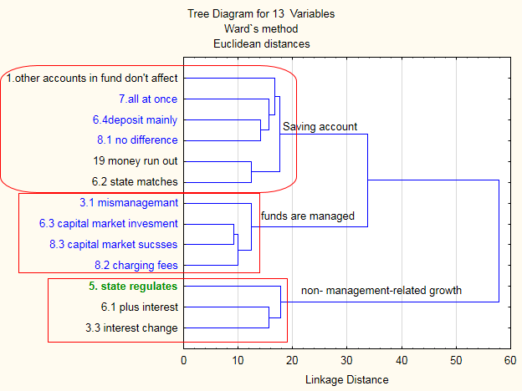
Factor extraction
Notes:
We could not find the grand stereotypical kind of attitude that we hypothesized
We binary coded the questions to match our predictions regarding to the naïve models
We calculated distances between qustions based on the similarity patterns of the responces
We ran factor analysis in order to check factor loading into the ingredients
בדקנו מרחקים סמנטיים בין השאלות, דפוסי מענה דומים
סדקנו את טעינת הגורמים ואת מהימנות הגורמים
מצאנו מספר מדדי ידע- הבול

Slide 11
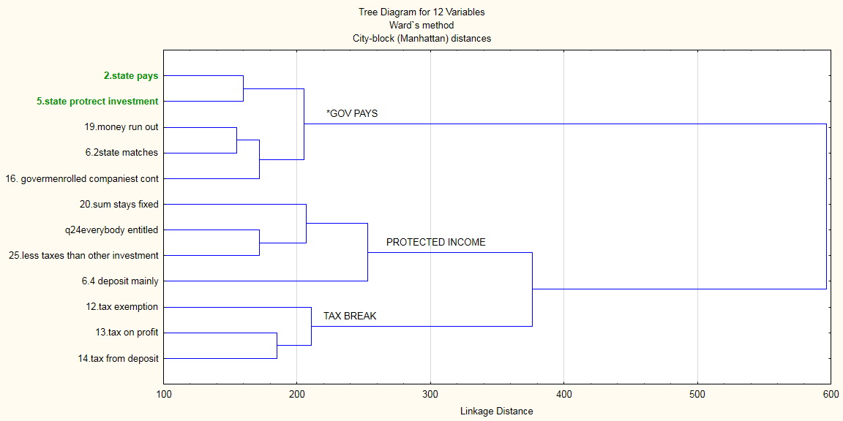
Factor extraction

Slide 12
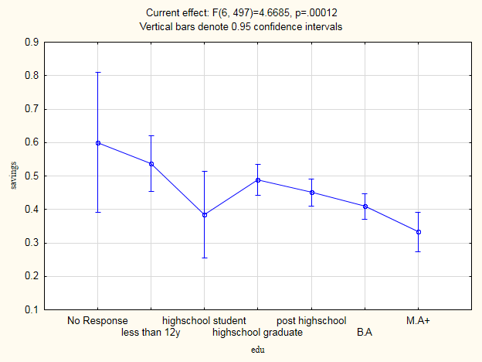
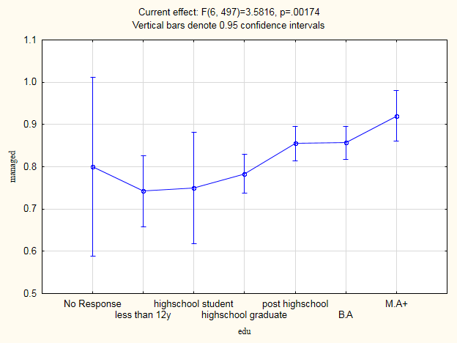
Education

Slide 13
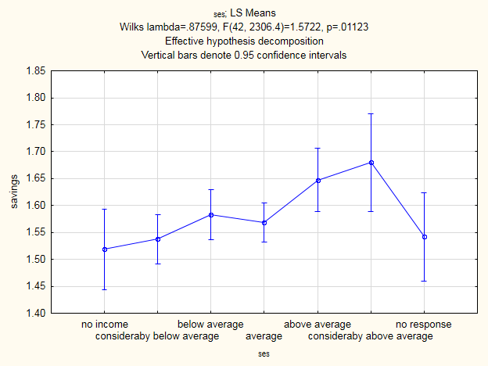
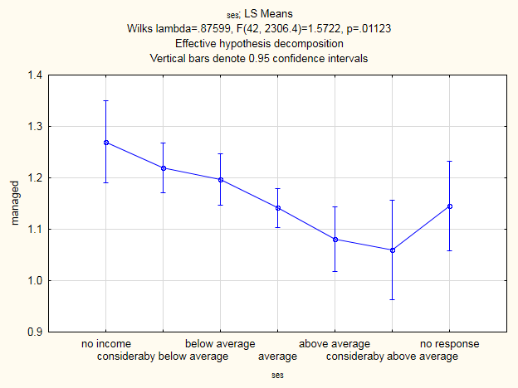
Socieconomic Status

Slide 14
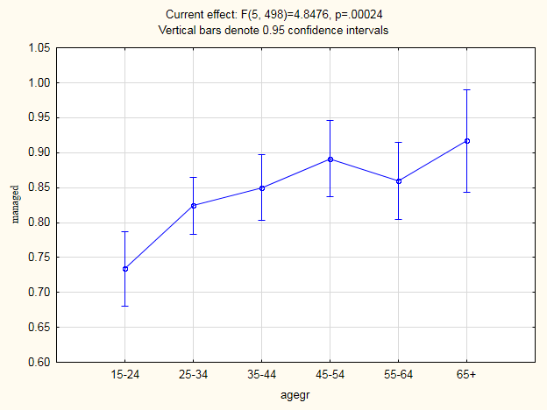
Age group

Slide 15
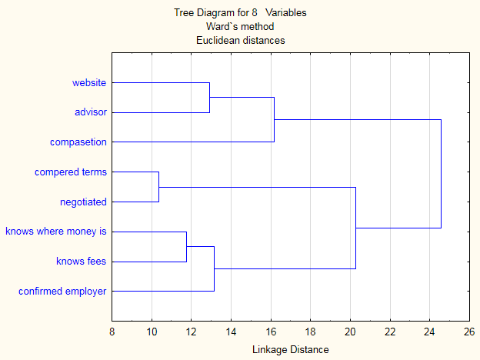
Behavioral measurements
External sources of information
negotiation
account monitoring
Notes:
We added the question about the reports to the monitoring measurment
we made an overall behavioral measuerment

Slide 16
Predicting behavior
Regression Summary R= .31952410 R²= .10209565 Adjusted R²= .09851120 F(2,501)=28.483 p
 | b* | Std.Err. - of b* | b | Std.Err. - of b | t(501) | p-value
Intercept |  |  | 0.123033 | 0.050704 | 2.42652 | 0.015596
savings | -0.091376 | 0.044090 | -0.098185 | 0.047375 | -2.07249 | 0.038731
managed | 0.281714 | 0.044090 | 0.301231 | 0.047145 | 6.38951 | 0.000000

Slide 17
Correlation between measurements
 | negotiation | External information | savings | managed | external | state participation | state protection | taxes
account monitoring | 0.46 | 0.30 | -0.12 | 0.27 | 0.07 | -0.10 | 0.01 | 0.10
negotiation |  | 0.41 | -0.15 | 0.22 | 0.08 | -0.04 | 0.05 | 0.09
External information |  |  | -0.12 | 0.23 | 0.05 | -0.09 | 0.09 | 0.10
savings |  |  |  | -0.28 | -0.14 | -0.06 | -0.12 | -0.14
managed |  |  |  |  | 0.38 | 0.15 | 0.16 | 0.06
external |  |  |  |  |  | 0.41 | 0.05 | 0.02
state participation |  |  |  |  |  |  | 0.02 | -0.08
state protection |  |  |  |  |  |  |  | 0.14
Notes:
Purple – behavior X behavior
Red – behavior X Knowledge
Brown – Knowledge X Knowledge

Slide 18
Questions and remarks
Notes:
Under represetation for minority groups
Self report measuring of behavior
Binary coding
Where do we go from here?
Targeting specific age group

